Slide 1
Service Delivery Indicators
Cross-Country Comparison of medical knowledge
Guinea Bissau, Kenya, Uganda, Madagascar, Malawi, Mozambique, NIGER, Nigeria, SIERRA LEONE, Tanzania, TOGO

Slide 2
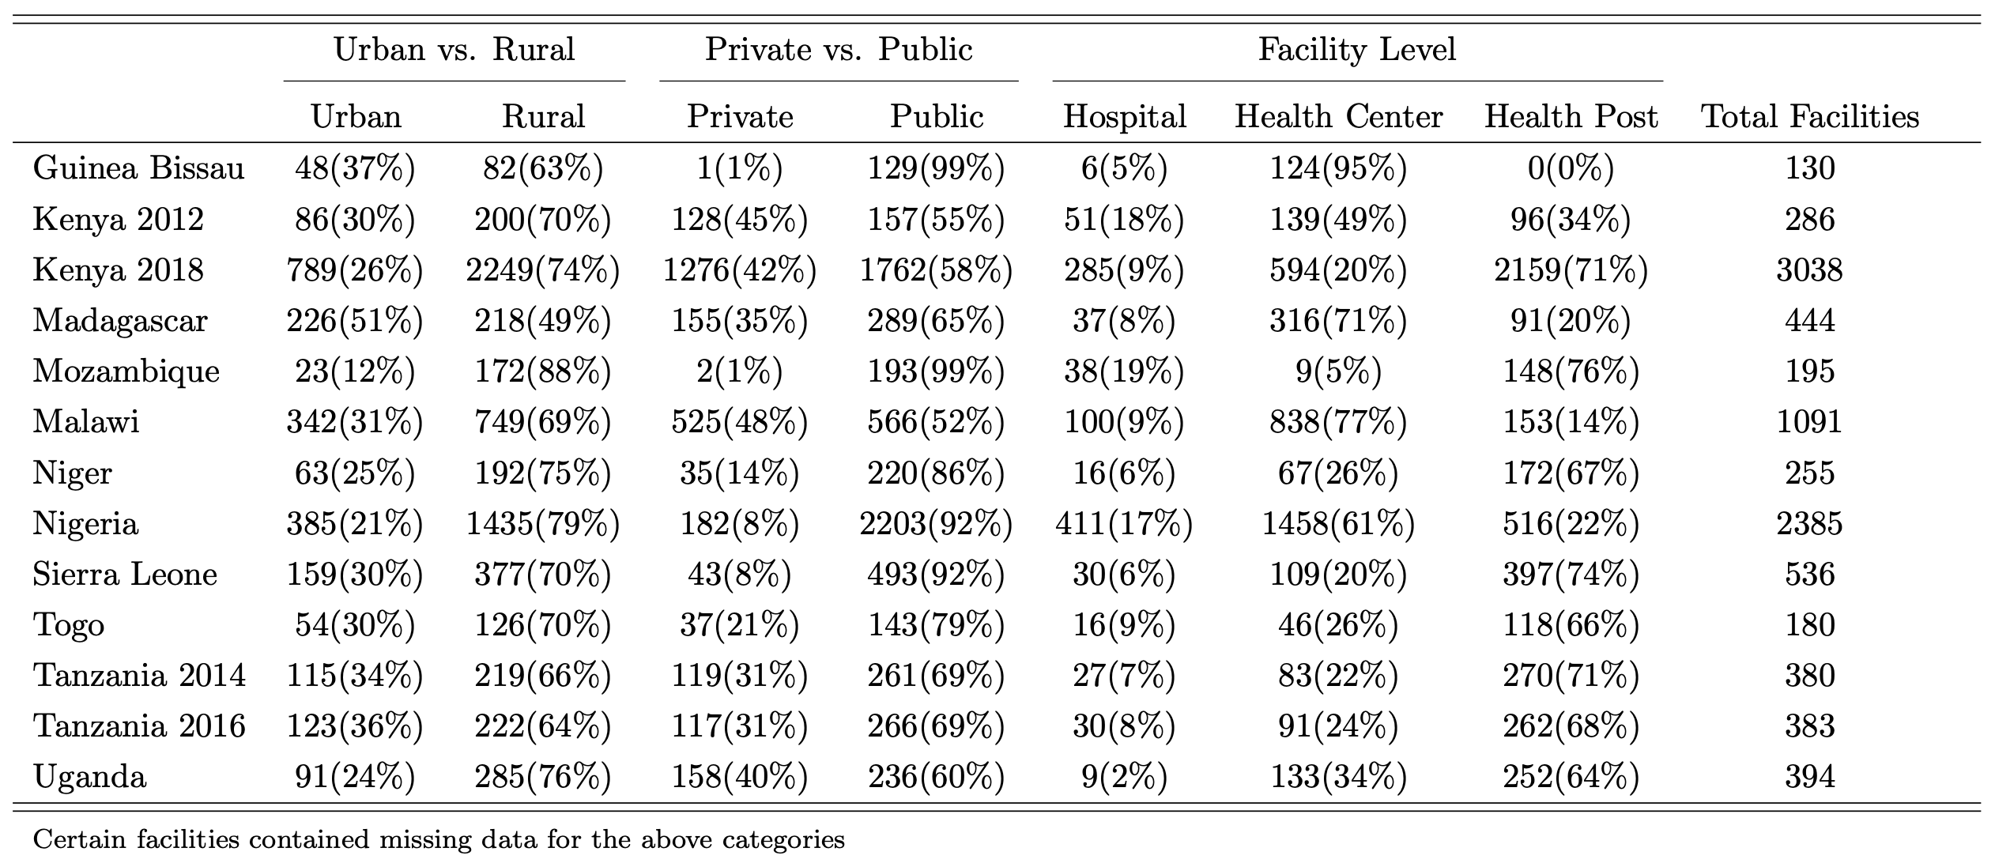
Facility Demography Summary
Facilities were selected in each country to provide a representative assessment of service delivery quality in public and private facilities located in rural and urban areas.
Facilities in the different countries were grouped into a common set of categories. Health posts were considered the lowest tier of health facility available, often staffed by a single individual and are without in-patient services. Health centers are larger, serving a greater population, but lack surgical services. Finally, hospitals are the top level of the health care system, typically able to provide all services an individual would seek.

Slide 3
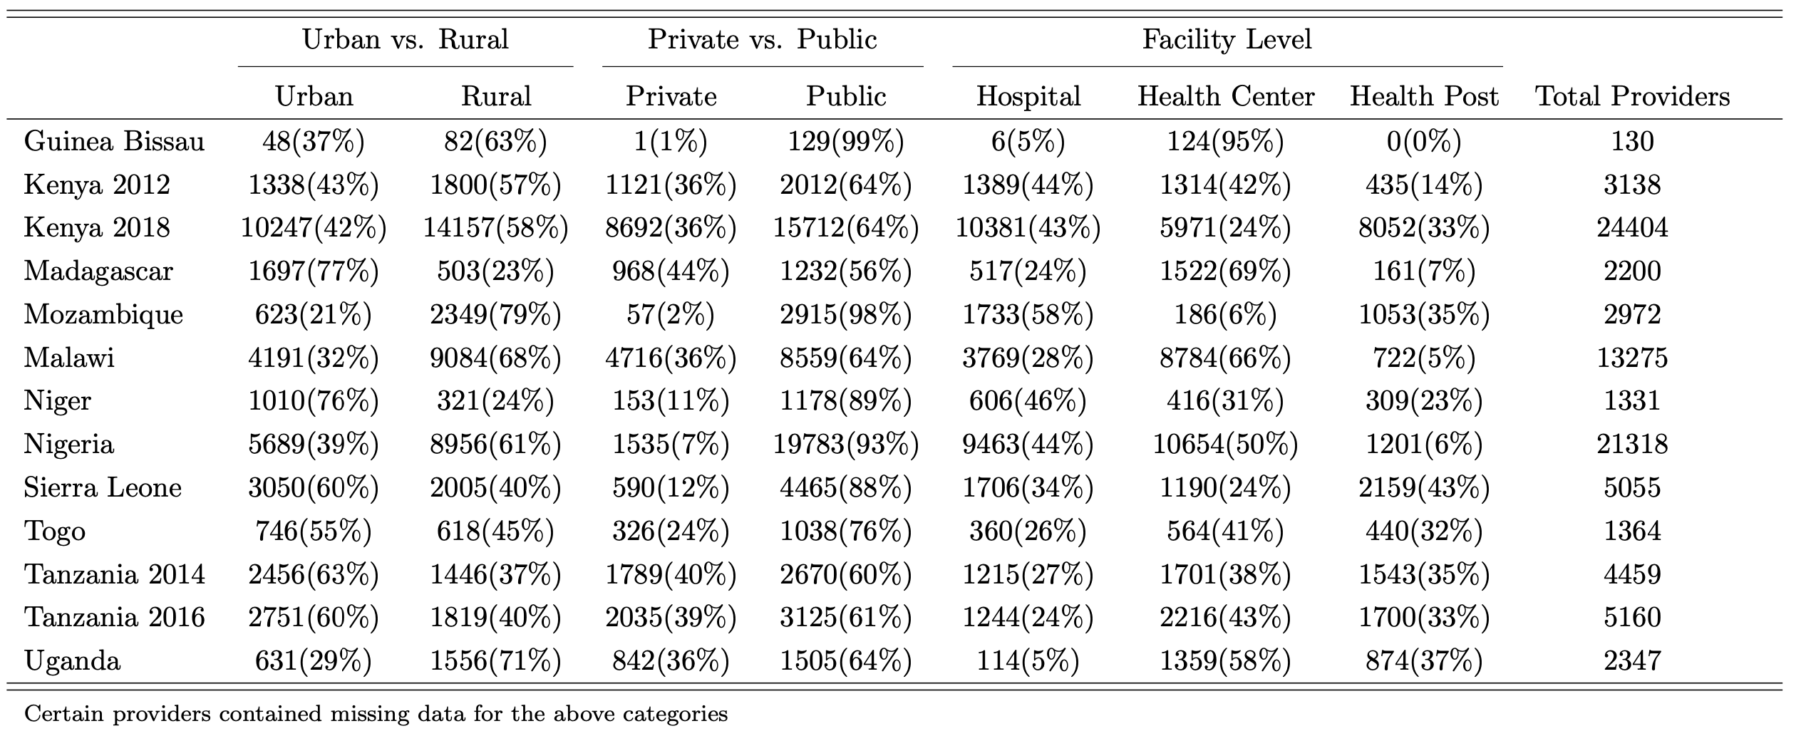
Provider Demography Summary
Multiple providers were selected within a particular facility to complete the vignette module of the SDI survey. If the facility only had a single provider, that provider completed the module. Across the entire sample, 3 providers were surveyed from each facility, on average.

Slide 4
Vignettes: Description
 | Script | Treatment
Acute diarrhea w/ dehydration | “I am a mother of a 13 month old boy. His name is Noel. My son has diarrhea.” | IV fluid rehydration, nasogastric tube rehydration, ORS rehydration, ORS education, zinc.
Pneumonia | “I am the mother of this 5 year old girl. Her name is Sia. She has a cough.” | Amoxicillin (or dosage), a first-line antibiotic, and any anti-pyretic.
Diabetes (Type II) | “My name is Jack. I am worried that something is wrong with me. I feel weak and without energy even though I feel hungry often and eat frequently. I am 48 years old and work as a clerk.” | Oral hypoglycemic, insulin when oral hypoglycemic are ineffective, referral to specialized clinic), referral to other clinic.
Tuberculosis | “My name is Bakari. I am 40 years old and I have been suffering from a fever and cough for some time.” | Sputum test, chest x-ray, combination therapy (or dosage, drug names, and timing), referral to TB clinic.
Malaria + Anemia | “I am the mother of this 4-year old boy. His name is Sangeti. He has had a fever for some time. Now he is worse, so I have come to you for help.” | Artemether-lumefantrine (or dosage), artemisinin combination therapy, chloroquine, paracetamol, and iron.
Post-Partum Hemorrhage | “My name is Fatuma. I am 26 years old and I have vaginal bleeding 24 hours after delivery in a health facility.” | Any uterotonics, an IV line, foley catheter, bimanual uterine massage.
Neonatal Asphyxia | “A mother gives birth to a baby. The newborn is not crying. The newborn fails to establish regular breathing and appears pail and slightly blue. What do you do?” | Call for help, dry baby, keep baby warm, check to see if baby is breathing, place baby in a natural position, initiate resuscitation with bag/mask, and check heartrate.
The enumerator delivers the initial script and providers are asked to proceed as though the actor were a real patient.
Gives pre-scripted:
Answers to history questions
Descriptions of what the provider would observe for a given physical exam
Results of a medical tests
Providers are then asked to make a diagnosis and may offer treatment recommendations but are not required to.

Slide 5
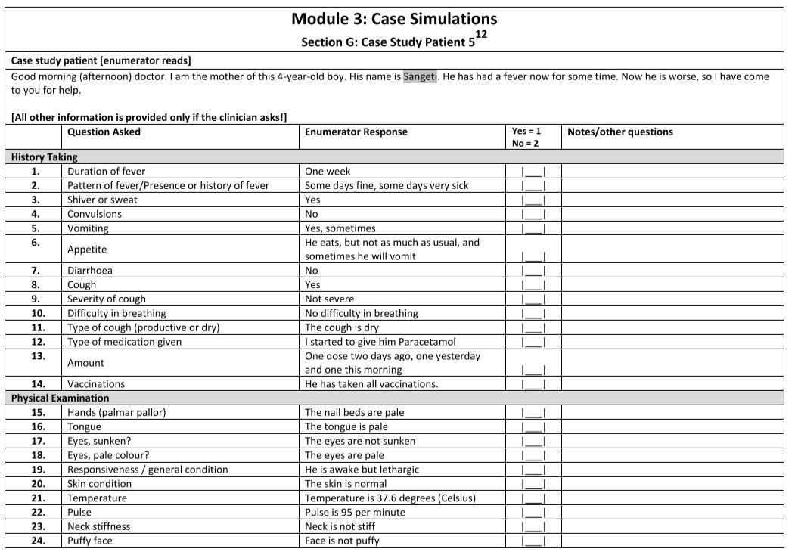
History and Examinations
The “patient” comes in presenting with some symptoms. The doctor can ask history questions and request examinations. For everything they ask, they are given a standardized answer.

Slide 6
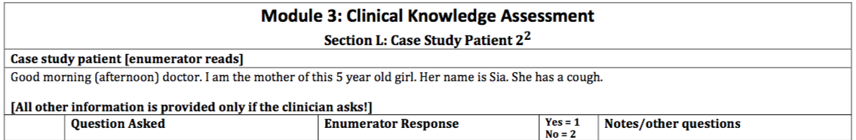
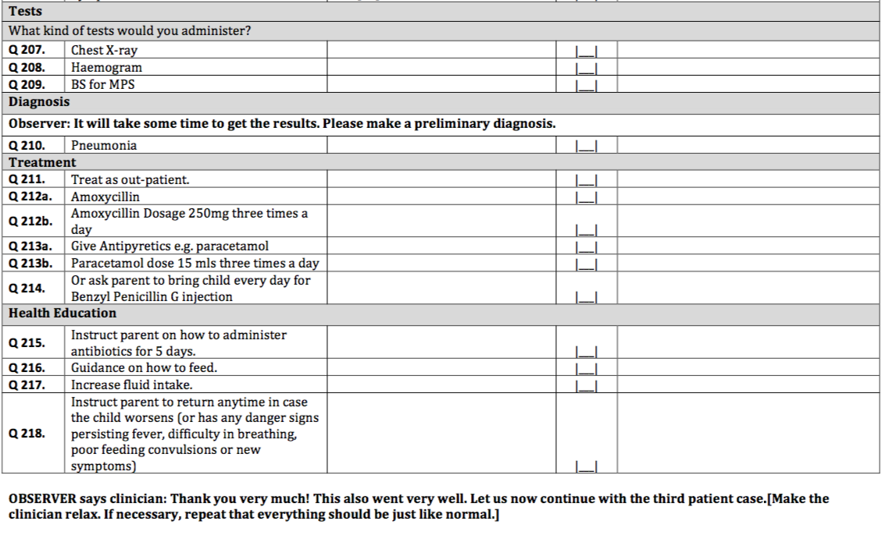
Diagnostic and treatment knowledge
When the provider is done with examinations, they are then asked for treatment options, including:
Diagnosis
Treatment
Inappropriate Antibiotics
Laboratory Tests
One data improvement here would be to record all meds and tests, unlike in the current vignette structure.

Slide 7
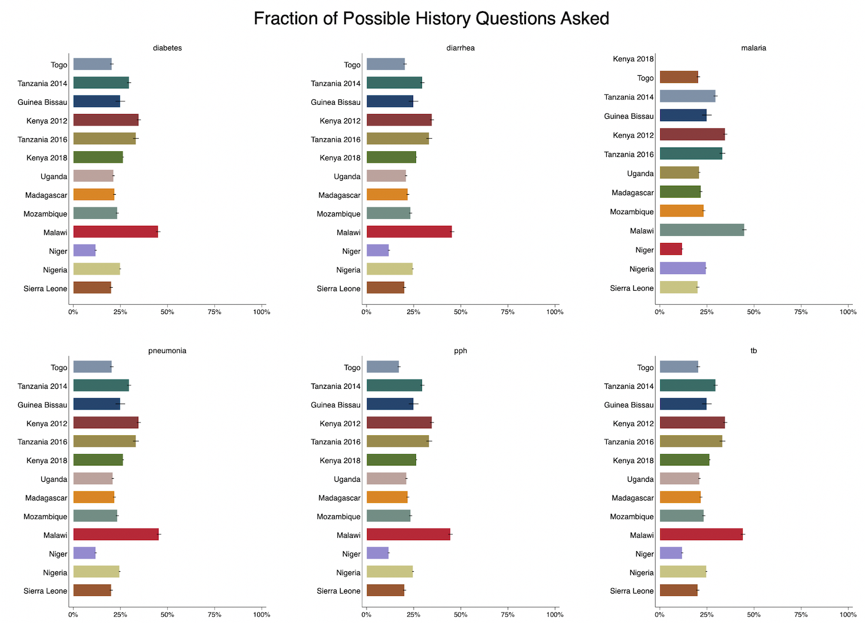
Comparing Across Vignettes: History Questions
These numbers seem low but remember that they are driven by the denominator. A provider doesn’t necessarily have to ask a lot of questions to get the diagnosis right.
We will use a statistical normalization method to put these in more context later in this presentation.

Slide 8
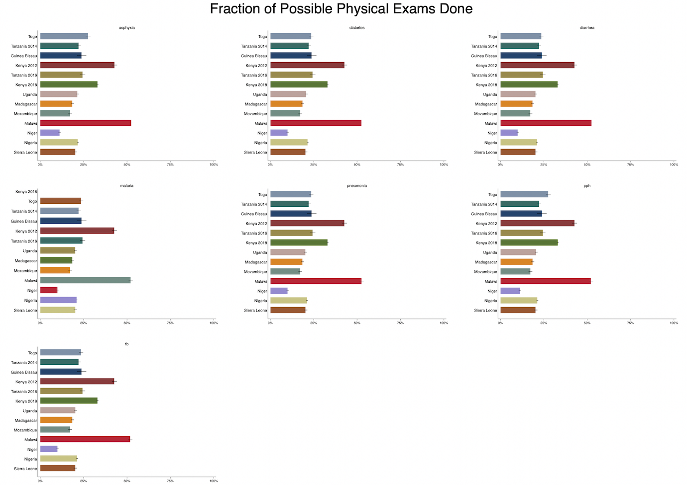
Comparing Across Vignettes: Physical Exams

Slide 9
Correct treatment: definitions
 | Strict Definition | Less Strict Definition
Diarrhea | Either: IV fluid rehydration nasogastric tube rehydration ORS rehydration zinc | Either: ORS plus zinc
Pneumonia | Only: amoxicillin (or dosage) | Also allow for: first-line antibiotic any anti-pyretic
Diabetes | Either: oral hypoglycemic insulin when oral hypoglycemic is ineffective referral to specialized clinic | Also allow for: referral to another clinician in same facility
Malaria | Either: artemether-lumefantrine (or dosage) artemisinin combination therapy chloroquine | Also allow for: paracetamol iron
Tuberculosis | Either: sputum test chest x-ray combination therapy (or dosage, drug names, and timing) | Also allow for: referral to TB clinic
Post-Partum Hemorrhage | Either: determine cause any uterotonics an IV line foley catheter bimanual uterine massage | Also allow for: oxytocin another uterotonic drug misoprostol ergometrine prostaglandin
Neonatal Asphyxia | Either: Cry for help Dry baby Keep baby warm Check if baby is breathing Place baby in natural position Initiate resuscitation with bag/mask Check heartrate | Also allow for: At least half of the 7 options in the strict definition
There is a fair amount of difference across settings in treatment options.
For this analysis, we graded treatment the same way for all providers using the less strict definition of accurate treatment listed here.
The post-partum hemorrhage and neonatal asphyxia vignettes require a management protocol are were not evaluated as “correct”.

Slide 10
Coding “Accurate Diagnosis”
 | Strict Definition | Less Strict Definition
Diarrhea | Either: “acute diarrhea with severe dehydration” “acute diarrhea” and “severe dehydration” | Either: “acute diarrhea with severe dehydration “acute diarrhea”, “moderate dehydration”, and “severe dehydration” “acute diarrhea”
Pneumonia | Only: “pneumonia” | n/a
Diabetes | Only: “diabetes (type II)” | Either: “diabetes (type II)” “diabetes”
Tuberculosis | Only: “tuberculosis” | n/a
Malaria | Either: “malaria with anemia” “malaria” and “anemia” | Either: “malaria with anemia” “malaria” and “anemia” “malaria” “simple malaria”
Post-Partum Hemorrhage | Only: “post-partum hemorrhage” | n/a
Neonatal Asphyxia | Only: “neonatal asphyxia” | Either: “neonatal asphyxia” “respiratory distress”
In certain survey instruments, there was only a single item listed for diagnosis. However, in other survey instruments, there were multiple items listed. Given these inconsistencies, the following guidelines are used to create a common definition of “correct diagnosis” among the different countries.
For the analysis, the less strict definition of “correct diagnosis” was used.

Slide 11
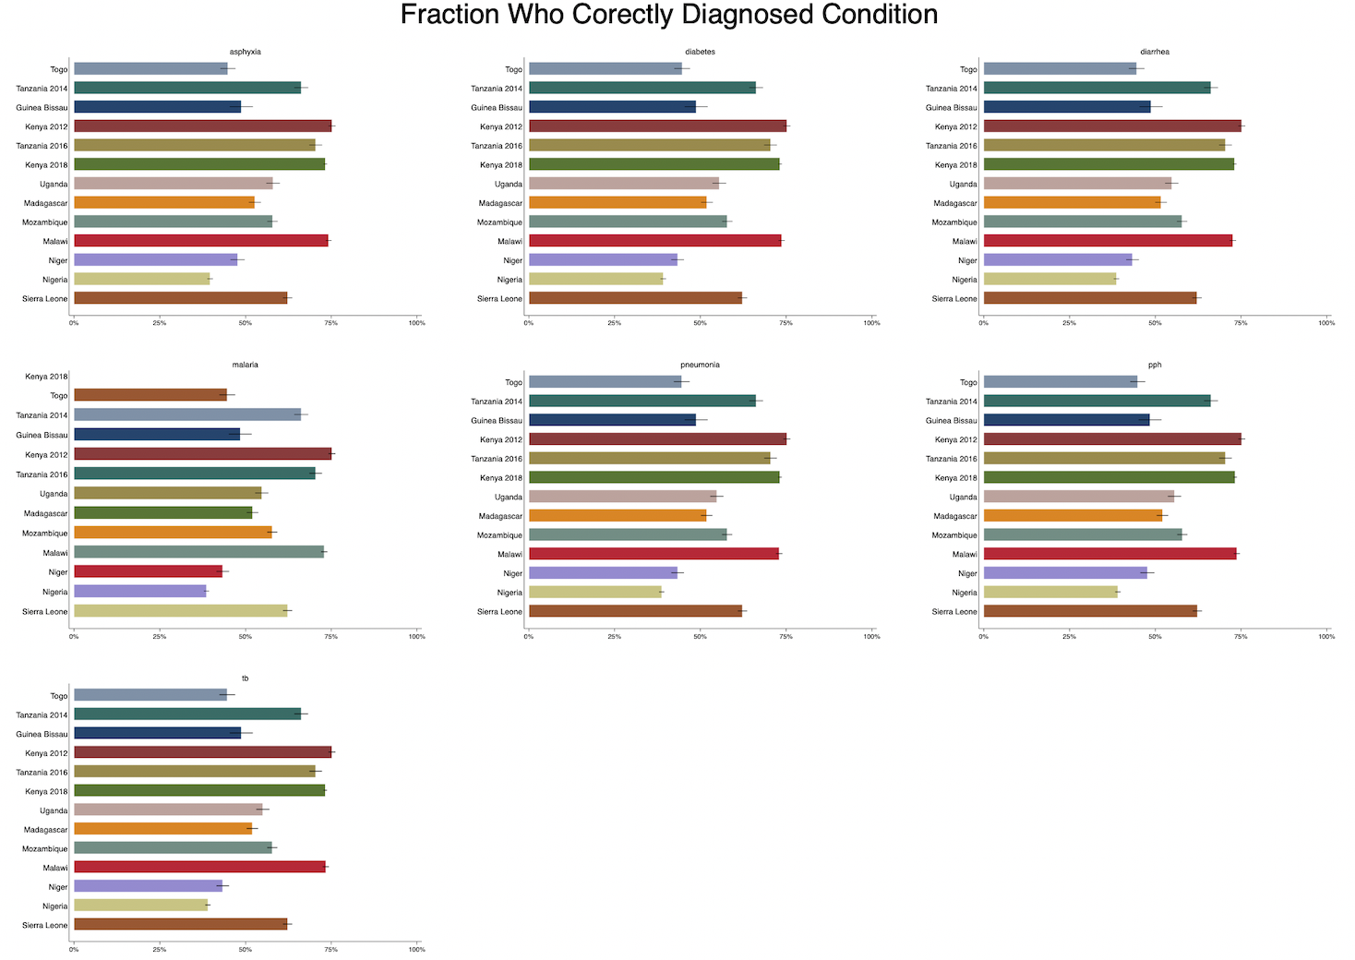
Comparing Across Vignettes: Correct Diagnoses
This question measures whether the provider correctly named the condition.
Similarly, there are often cultural differences in whether providers name medical conditions explicitly to patients (or whether they use specific terminology).

Slide 12
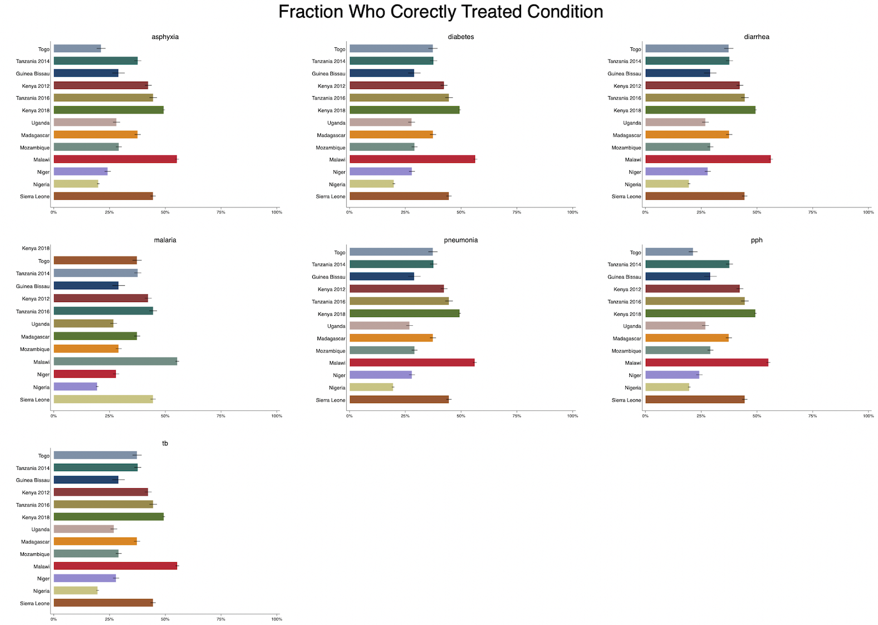
Comparing Across Vignettes: Correct treatment
Providers across the different countries are equally proficient at treating diarrhea, malaria, and tuberculosis.
Providers in Nigeria were slightly worse, on average, with regard to prescribing the appropriate treatment for most of the vignettes.

Slide 13
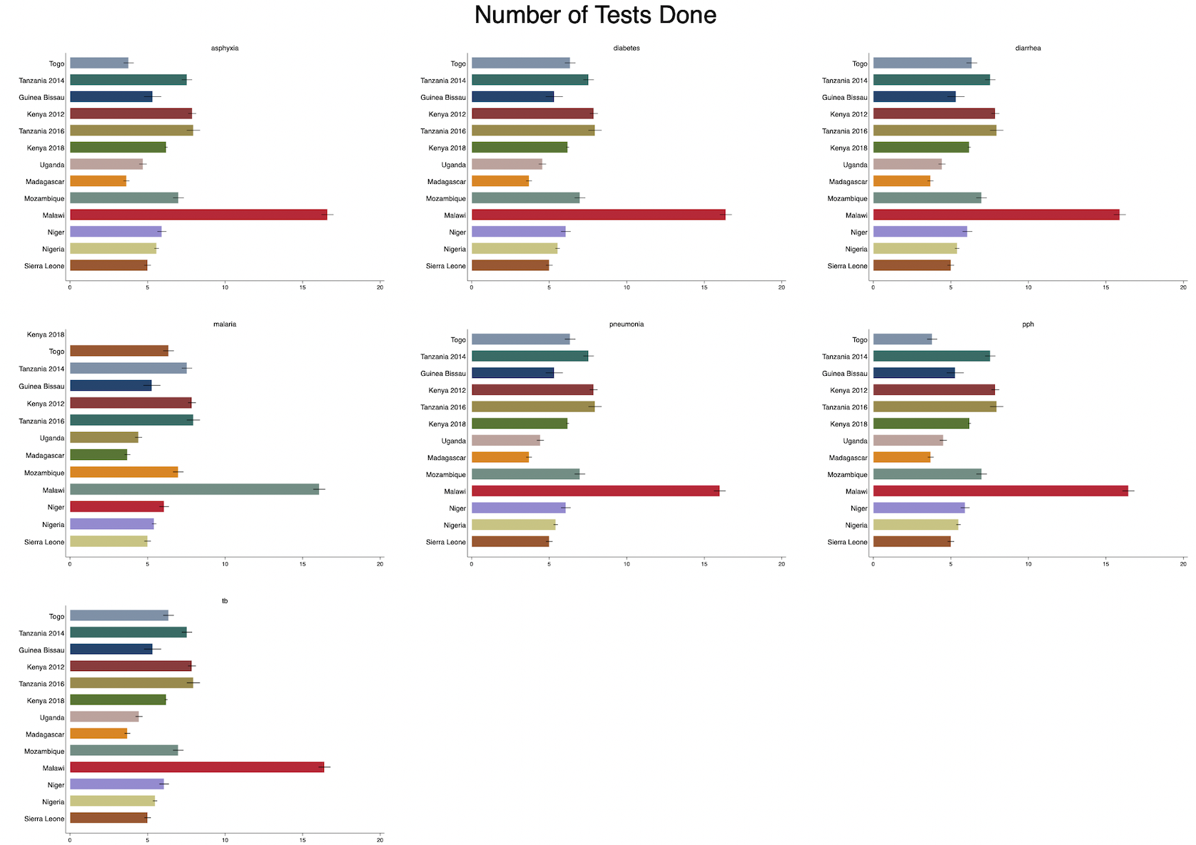
Comparing Across Vignettes: Tests
In general, most tests are ordered for diabetes, malaria, and tuberculosis; but again this is partly due to the data sheet structure. (And testing is appropriate in these cases.)
While varying in the number of tests prescribed for each vignette, providers in Malawi.

Slide 14
Using psychometrics to “score” vignettes and assess treatment variations
Create a diagnostic score for every provider based on history questions and exams. This score only relates providers to each other, and doesn’t say anything about “absolute” knowledge.
Assess management outcomes directly: we look at diagnosis, treatment, testing, and medicine separately as they relate to the abstract score.
If those relationships are statistically strong, then we can use variations in the diagnostic score to think about policy-relevant differences between countries, professional cadres, care levels, etc.

Slide 15
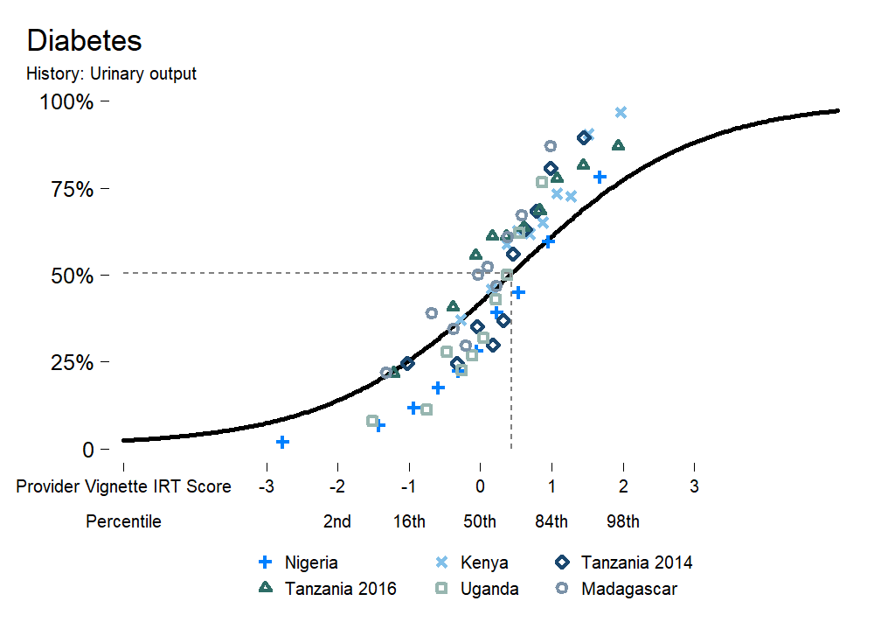
How do we read an IRT score?
Single diagnostic item
This is an example item response curve from the SDI data. Each provider is given a single overall score (X-axis).
For every item, that score predicts how likely that provider was to complete that item (response curve). The distribution is approximately standard normal, so:
Average provider score = 0
IQR is -0.68 to +0.68
Ability-response curve (estimated by IRT)
Bottom providers overall
Median providers
Top providers overall
True outcomes:

Slide 16
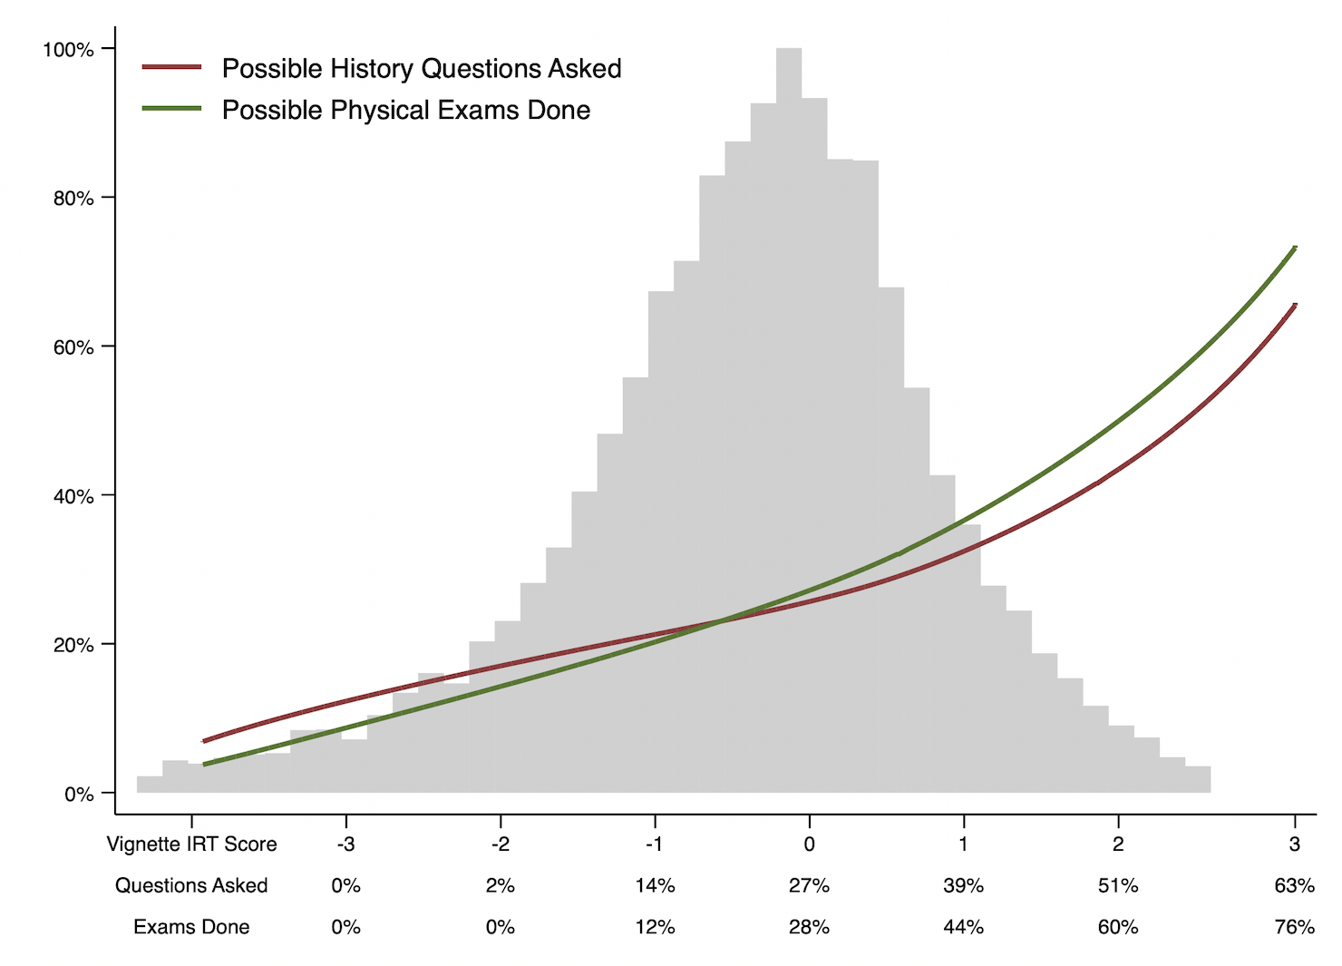
What does the score distribution look like?
For the rest of the presentation, we will reference overall scores instead of individual items. This chart summarizes how performance measures varied across the score distribution in all SDI data when analyzed by IRT.
The box plot shows the 5th, 25th, 50th, 75th, and 95th percentiles for reference. As you can see, this is again a dataset with a “long tail” at the bottom of the distribution.
Full distribution (histogram)
IRT scores are non-linear in actual behaviors

Slide 17
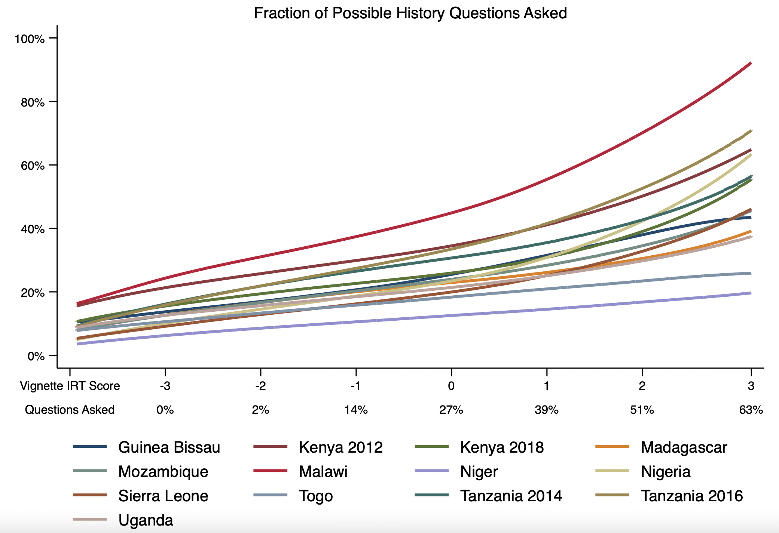
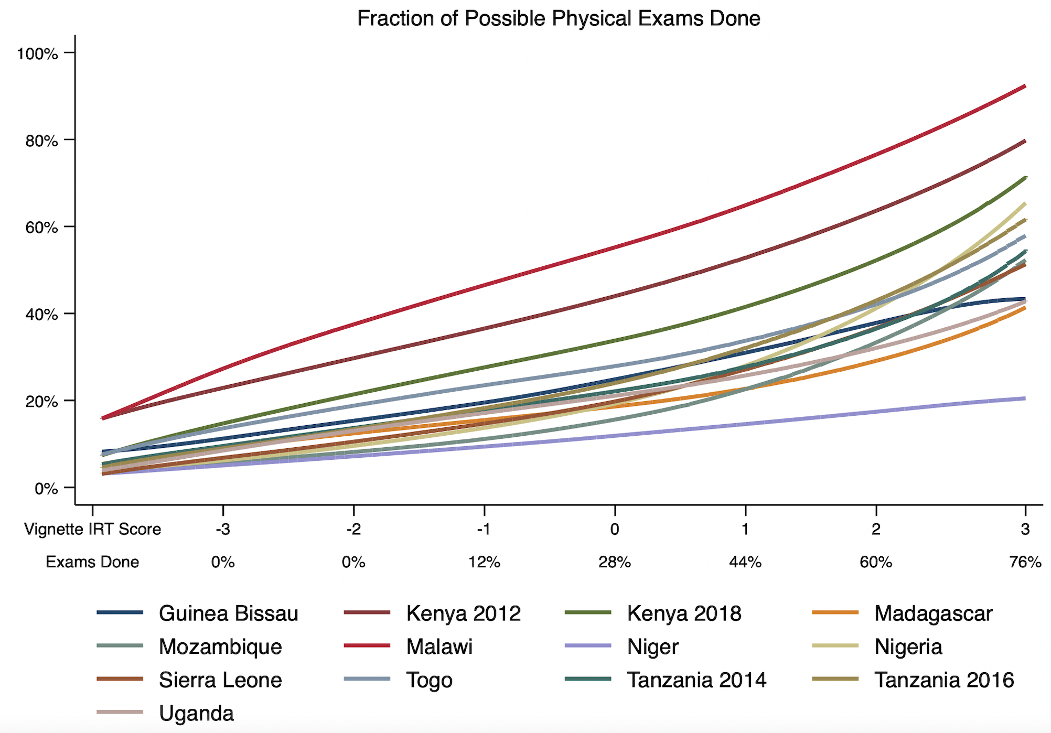
Benchmarking IRT vignettes scores
The key point to note is that this strongly validates the use of IRT as a summary index for SDI. All countries fall on about the same curve relating IRT score to the actual proportion of history questions and physical exams they completed.

Slide 18
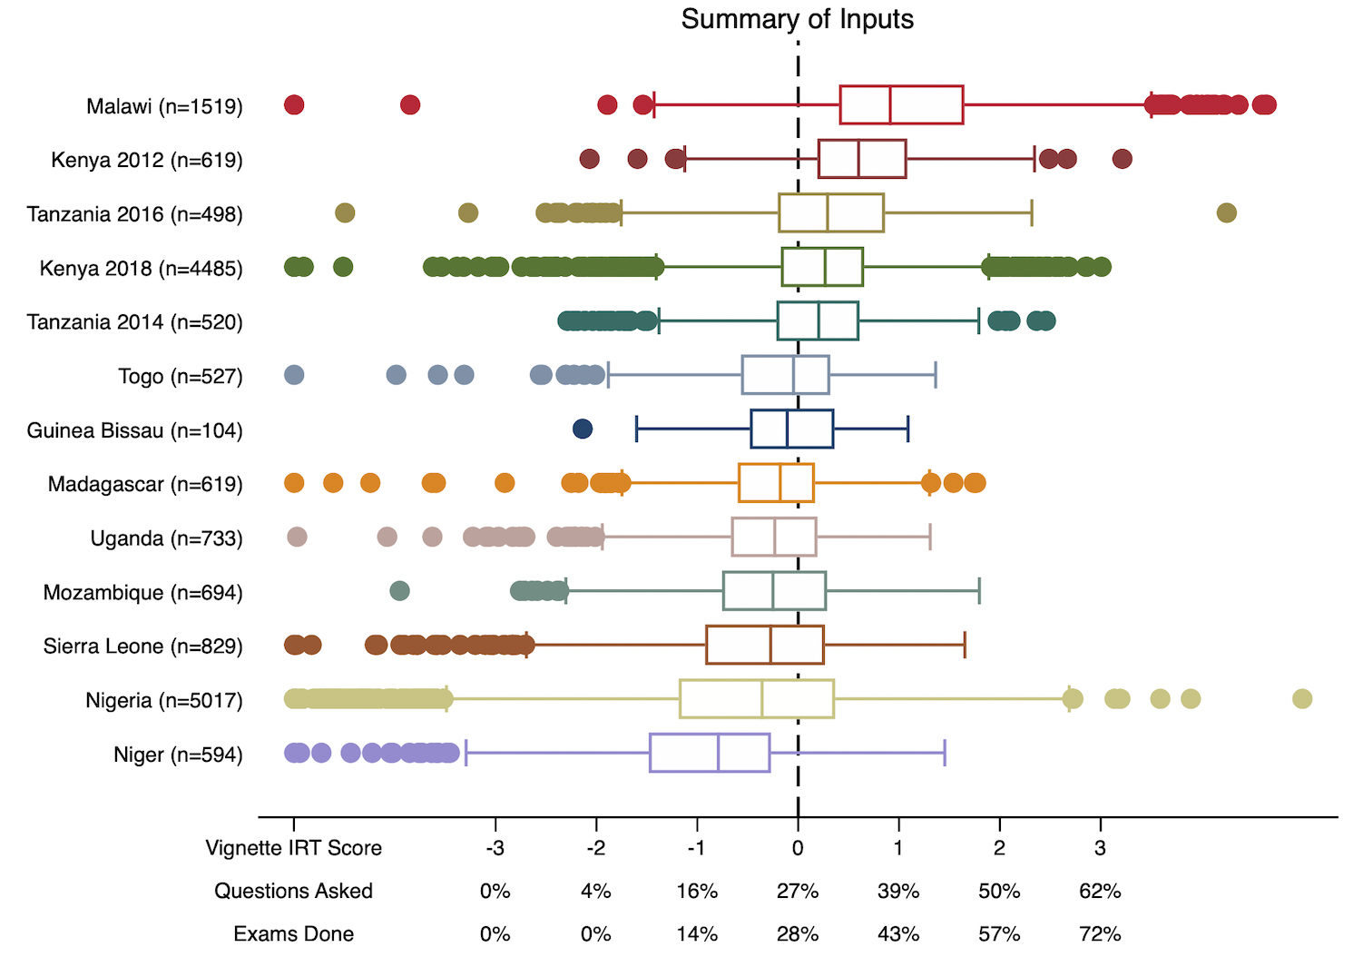
Cross-country Ability Score Distributions
Providers at the 50th percentile of the overall distribution only ask and do about 25% of the history questions and physical exams. Those at the 95th percentile ask and do 50% of the possible history questions and physical exams.
Key distributional questions:
Is a country with many low-knowledge providers “bad”, if it also has many high-knowledge providers? (see Nigeria)
How informative is “average” in that case?
Concrete equivalents for reference

Slide 19
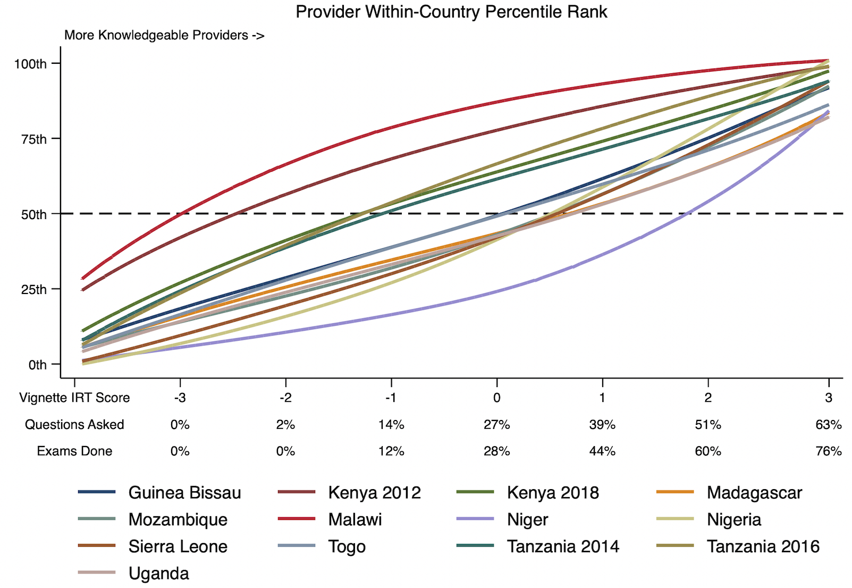
Within-country Ability Score Distributions
This graph answers the question: How knowledgeable is the 50th-percentile provider in each country? The 95th?

Slide 20
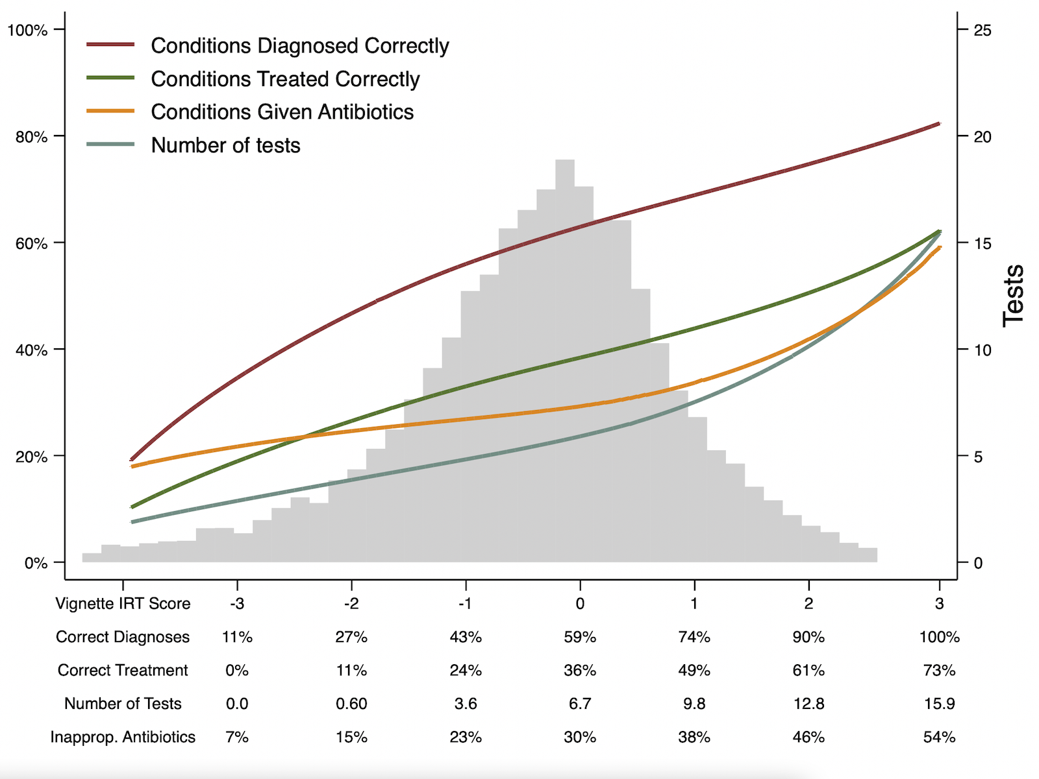
IRT Scores predict correct management – and unnecessary management.
The IRT score is a good predictor of diagnostic and treatment accuracy. It is also a good predictor of the number of tests ordered by a provider, and the number of unnecessary antibiotics provided across the vignettes.

Slide 21
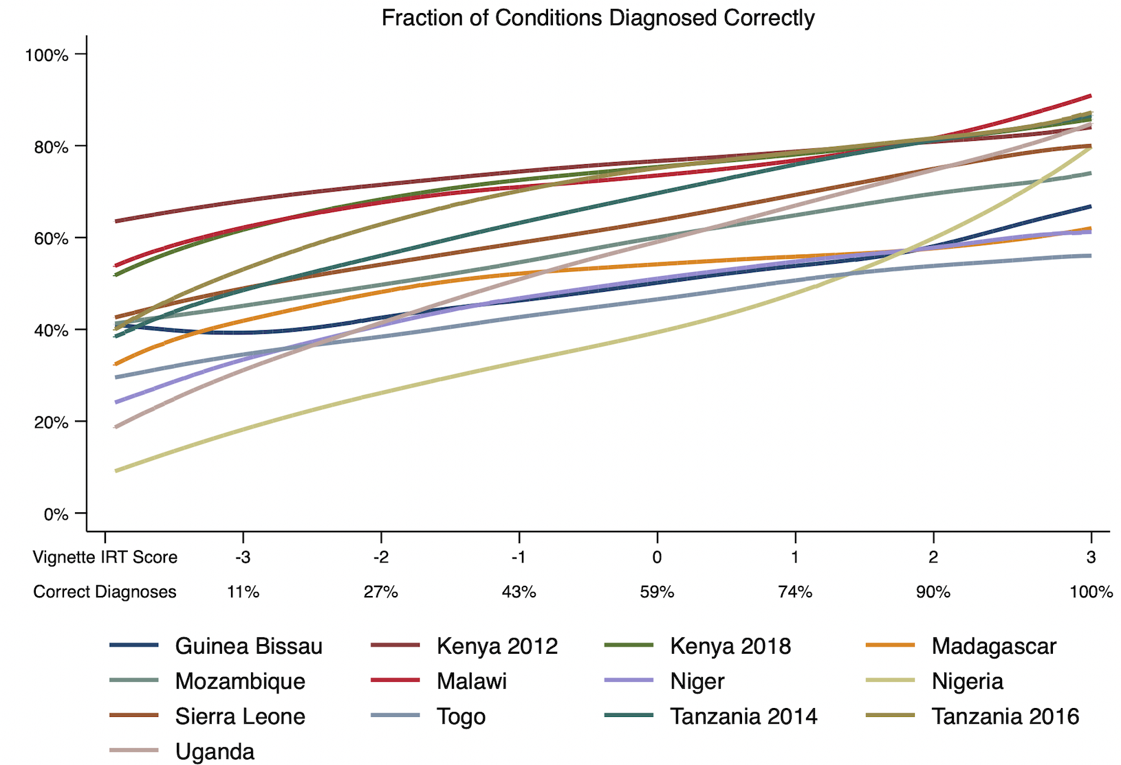
IRT is a predictor of diagnosis across countries.
In Kenya 2012, all providers can accurately diagnose at least 60% of the conditions.
In the other countries, the worst providers range from being able to diagnose 10% of the conditions in Nigeria to 50% of the conditions in Tanzania and Malawi.

Slide 22

IRT is a predictor of treatment across countries.
Providers in Uganda and Nigeria, fair the worst when it comes to correctly treating the given diagnostic.

Slide 23
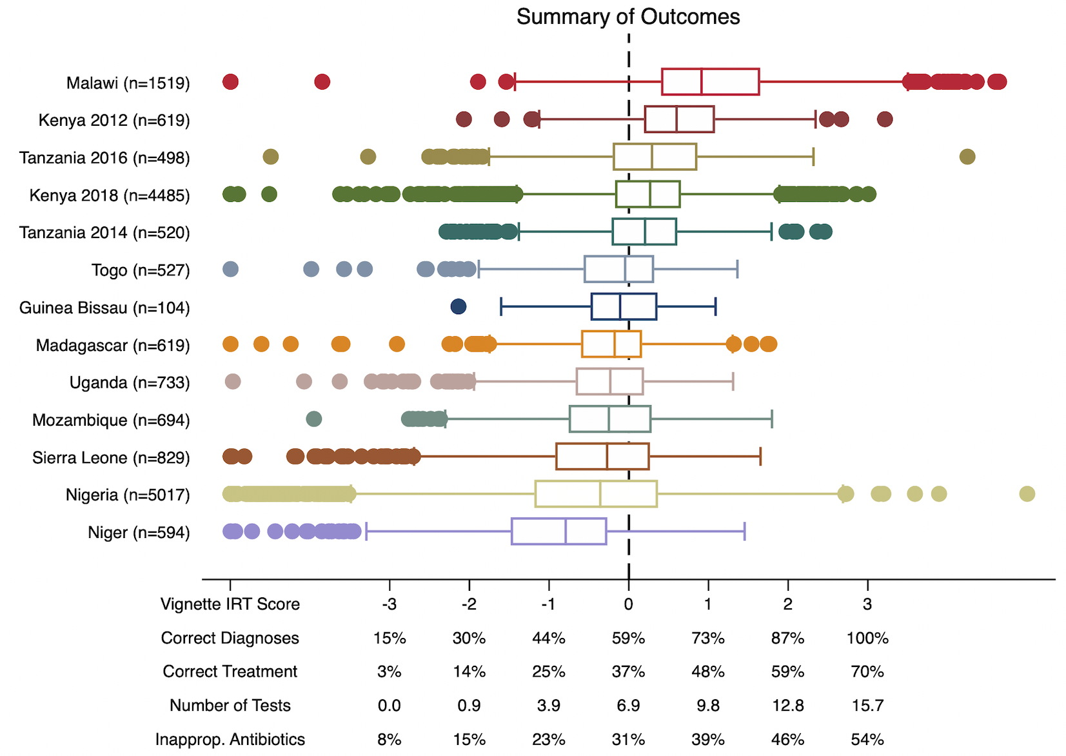
Summary: Variation Across Countries
An increase in one standard deviation of vignette IRT score (the difference between the worst and best performing countries, on average) leads to:
14% more conditions diagnosed correctly
11% more conditions treated correctly
Over 3 more tests ordered
8% more of the conditions given inappropriate antibiotics.
On average across the countries, more knowledgeable providers do prescribe inappropriate antibiotics at a greater rate.

Slide 24
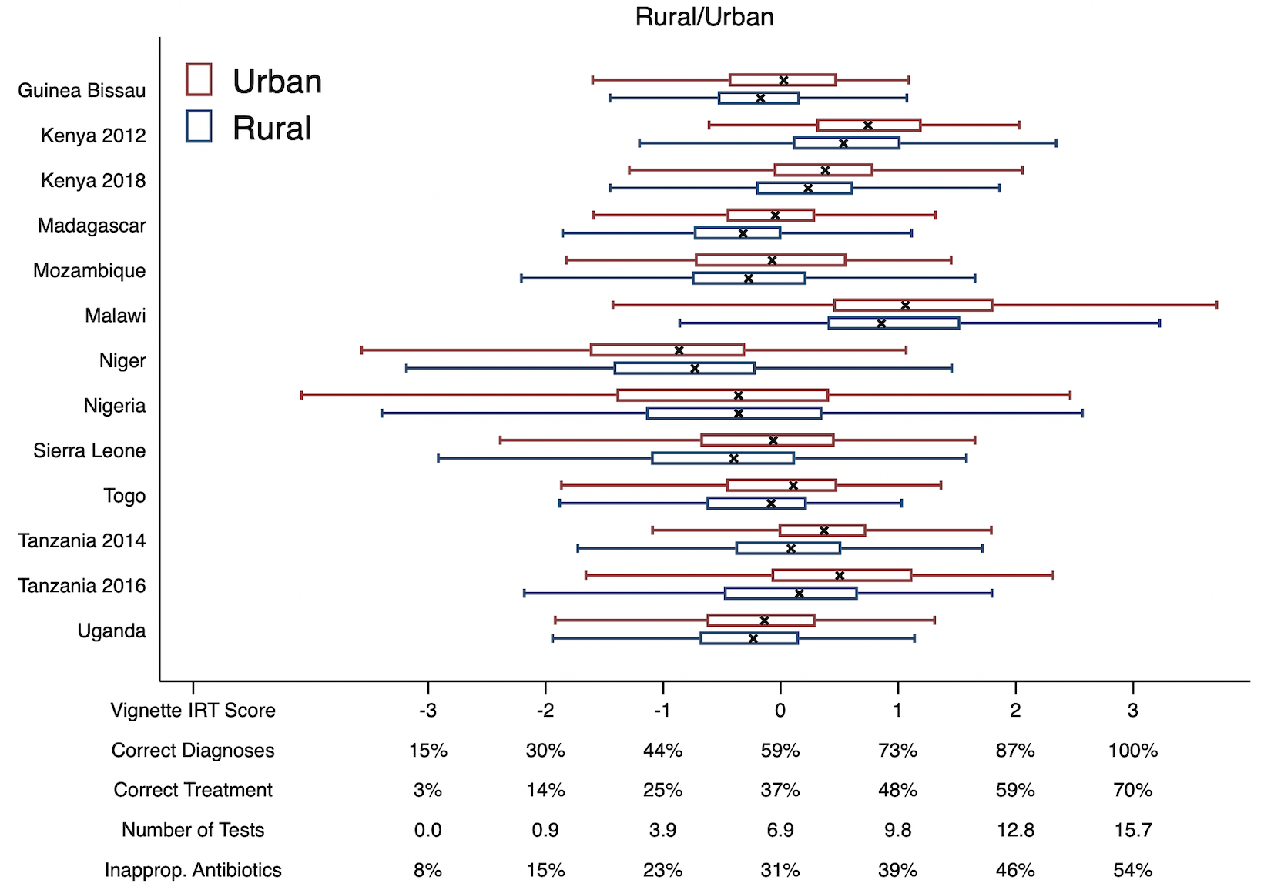
Rural-Urban Variation
Urban providers are more knowledgeable on average than rural providers in all countries except Niger.
The largest difference between rural and urban providers occurs in Tanzania, where they are nearly half a standard deviation apart, and the gap at the top of the distribution has grown between rounds.

Slide 25
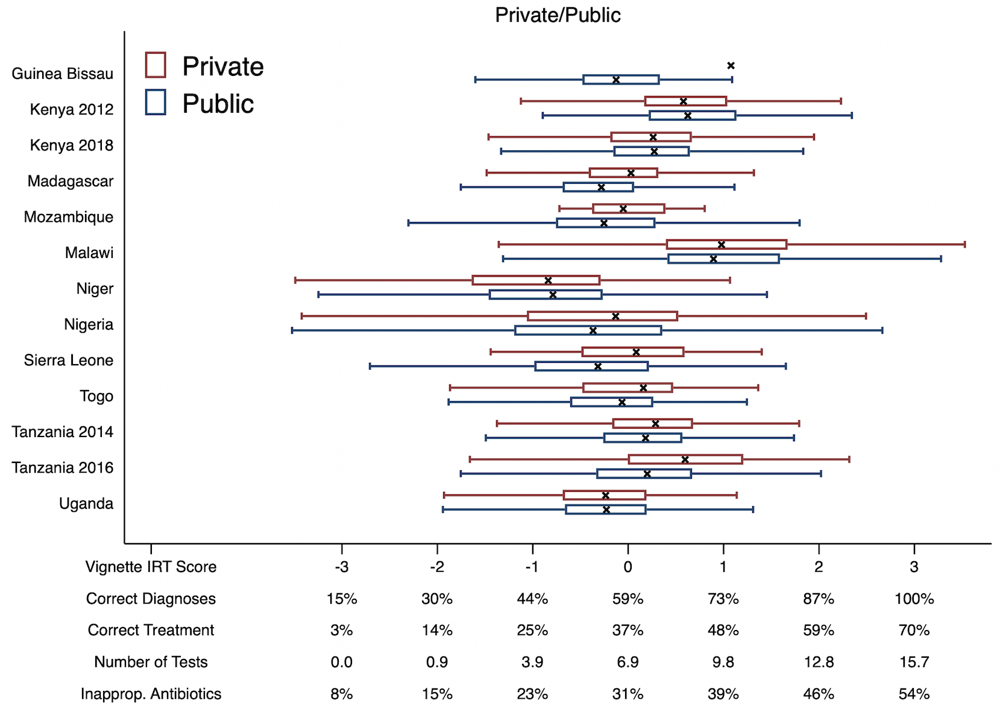
Public-Private Variation
Private providers are more knowledgeable than public providers in most countries, while in others they are equivalent.
The largest difference between public and private providers occurs again in Tanzania, where they are nearly half a standard deviation apart.

Slide 26
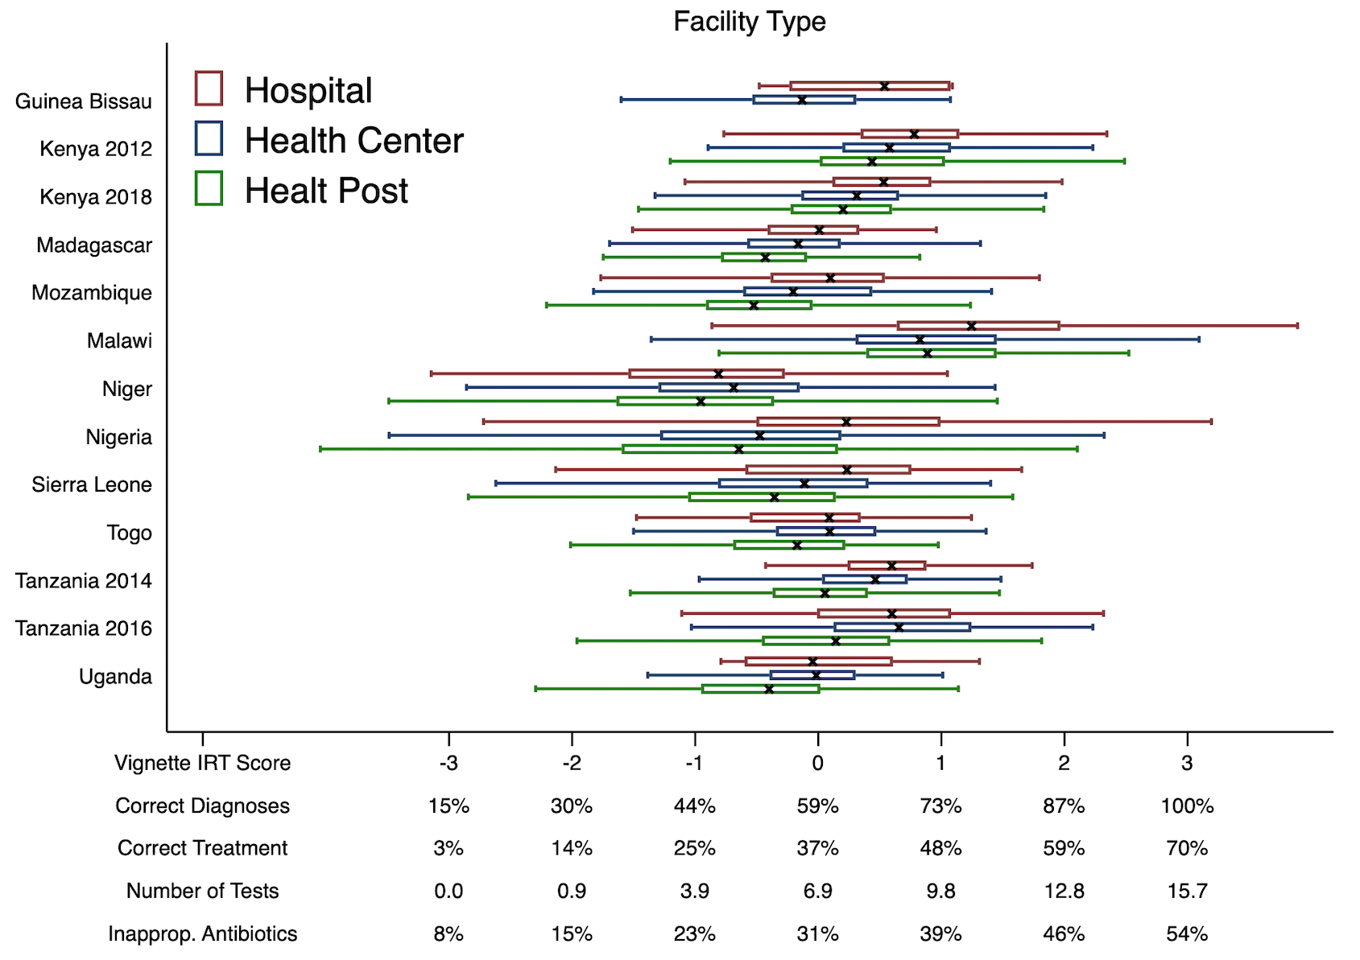
Facility Level Variation
In general, provider knowledge increases with the level of the health facility, but there is very wide variation in every group.

Slide 27
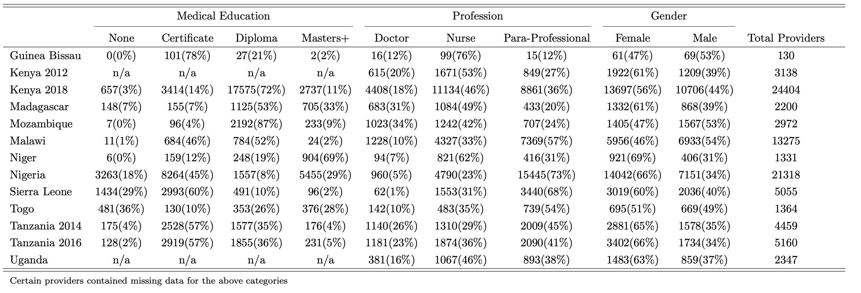
Provider Identity Summary
Providers in Kenya 2012 and Uganda were not asked survey questions related to their medical education.
A common set of categories for medical education and profession were applied across all contexts to allow for better comparison.

Slide 28
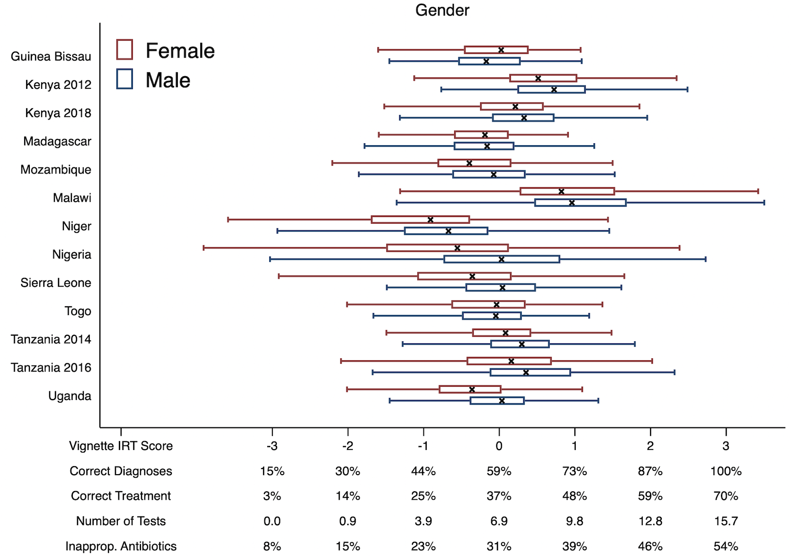
Male-Female Variation
Male providers are more knowledgeable than female providers in all countries except Togo, Guinea Bissau, and Madagascar.
Similarly, the best providers in most countries tend to be male.

Slide 29
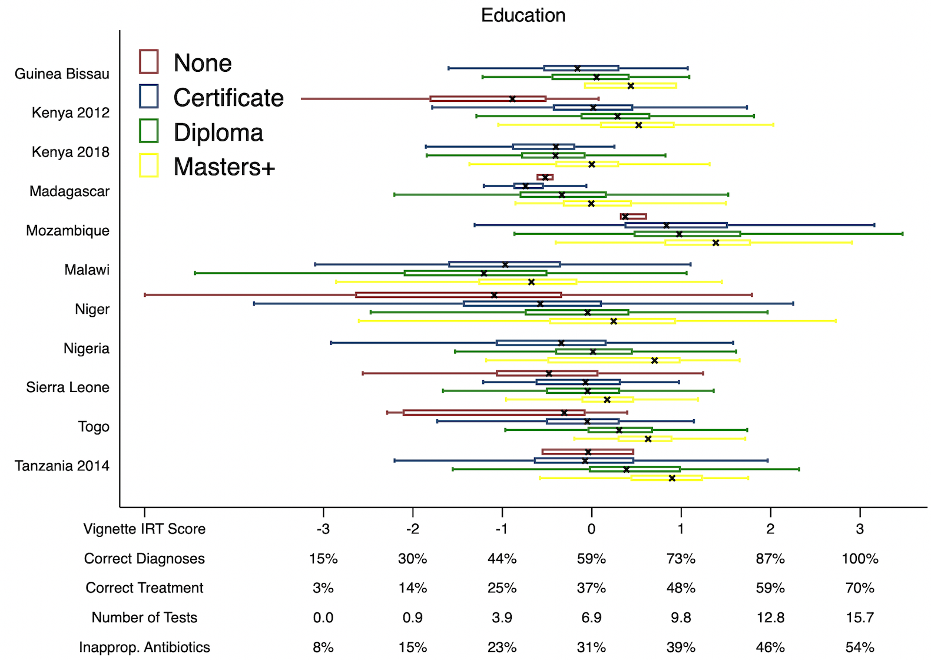
Educational Variation
Diagnostic knowledge also increases generally with educational level, although there remains very wide variation within the groups in every setting.

Slide 30
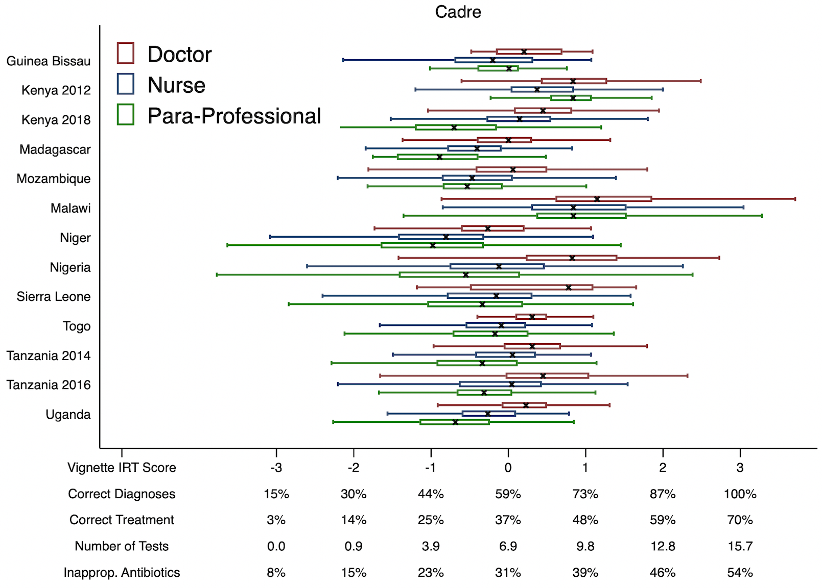
Professional Variation
Similarly, higher cadre providers tend to be more knowledgeable.

